Slide 1
Operating System Concepts
Course Code: CSC 2209
Course Title: Operating Systems
Dept. of Computer Science
Faculty of Science and Technology
Lecturer No: |  | Week No: |  | Semester: | Spring 22-23
Lecturer: | Noboranjan Dey

Slide 2
Lecture Outline
Background
Logical and Physical Address Space
Static and Dynamic Loading
Swapping
Fragmentation
Paging
Virtual Memory

Slide 3
Background
Program must be brought (from disk) into memory and placed within a process for it to be run
Main memory and registers are only storage CPU can access directly
Memory unit only sees a stream of:
addresses + read requests, or
address + data and write requests
Register access is done in one CPU clock (or less)
Main memory can take many cycles, causing a stall
Cache sits between main memory and CPU registers
Protection of memory required to ensure correct operation

Slide 4
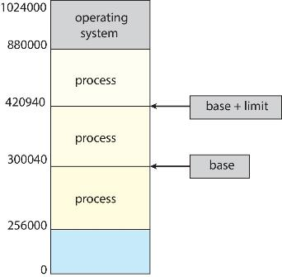
Protection
Need to ensure that a process can access only those addresses in its address space.
We can provide this protection by using a pair of base and limit registers define the logical address space of a process

Slide 5
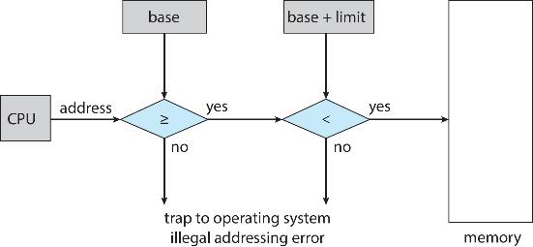
Hardware Address Protection
CPU must check every memory access generated in user mode to be sure it is between base and limit for that user
the instructions to loading the base and limit registers are privileged

Slide 6
Address Binding
Programs on disk, ready to be brought into memory to execute form an input queue
Without support, must be loaded into address 0000
Inconvenient to have first user process physical address always at 0000
How can it not be?
Addresses represented in different ways at different stages of a program’s life
Source code addresses usually symbolic
Compiled code addresses bind to relocatable addresses
i.e., “14 bytes from beginning of this module”
Linker or loader will bind relocatable addresses to absolute addresses
i.e., 74014
Each binding maps one address space to another

Slide 7
Binding of Instructions and Data to Memory
Address binding of instructions and data to memory addresses can happen at three different stages
Compile time: If memory location known a priori, absolute code can be generated; must recompile code if starting location changes
Load time: Must generate relocatable code if memory location is not known at compile time
Execution time: Binding delayed until run time if the process can be moved during its execution from one memory segment to another
Need hardware support for address maps (e.g., base and limit registers)

Slide 8
Dynamic Loading
The entire program does need to be in memory to execute
Routine is not loaded until it is called
Better memory-space utilization; unused routine is never loaded
All routines kept on disk in relocatable load format
Useful when large amounts of code are needed to handle infrequently occurring cases
No special support from the operating system is required
Implemented through program design
OS can help by providing libraries to implement dynamic loading

Slide 9
Logical vs. Physical Address Space
The concept of a logical address space that is bound to a separate physical address space is central to proper memory management
Logical address – generated by the CPU; also referred to as virtual address
Physical address – address seen by the memory unit
Logical and physical addresses are the same in compile-time and load-time address-binding schemes; logical (virtual) and physical addresses differ in execution-time address-binding scheme
Logical address space is the set of all logical addresses generated by a program
Physical address space is the set of all physical addresses generated by a program

Slide 10
Swapping
A process can be swapped temporarily out of memory to a backing store, and then brought back into memory for continued execution
Total physical memory space of processes can exceed physical memory
Backing store – fast disk large enough to accommodate copies of all memory images for all users; must provide direct access to these memory images
Roll out, roll in – swapping variant used for priority-based scheduling algorithms; lower-priority process is swapped out so higher-priority process can be loaded and executed
Major part of swap time is transfer time; total transfer time is directly proportional to the amount of memory swapped
System maintains a ready queue of ready-to-run processes which have memory images on disk

Slide 11
Swapping (Cont.)
Does the swapped out process need to swap back in to same physical addresses?
Depends on address binding method
Plus consider pending I/O to / from process memory space
Modified versions of swapping are found on many systems (i.e., UNIX, Linux, and Windows)
Swapping normally disabled
Started if more than threshold amount of memory allocated
Disabled again once memory demand reduced below threshold

Slide 12
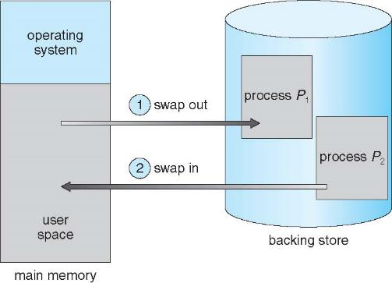
Schematic View of Swapping

Slide 13
Context Switch Time including Swapping
If next processes to be put on CPU is not in memory, need to swap out a process and swap in target process
Context switch time can then be very high
100MB process swapping to hard disk with transfer rate of 50MB/sec
Swap out time of 2000 ms or 2 sec
Plus swap in of same sized process
Total context switch swapping component time of 4000ms (4 seconds)
Can reduce if reduce size of memory swapped – by knowing how much memory really being used
System calls to inform OS of memory use via request_memory() and release_memory()

Slide 14
Context Switch Time and Swapping (Cont.)
Other constraints as well on swapping
Pending I/O – can’t swap out as I/O would occur to wrong process
Or always transfer I/O to kernel space, then to I/O device
Known as double buffering, adds overhead
Standard swapping not used in modern operating systems
But modified version common
Swap only when free memory extremely low

Slide 15
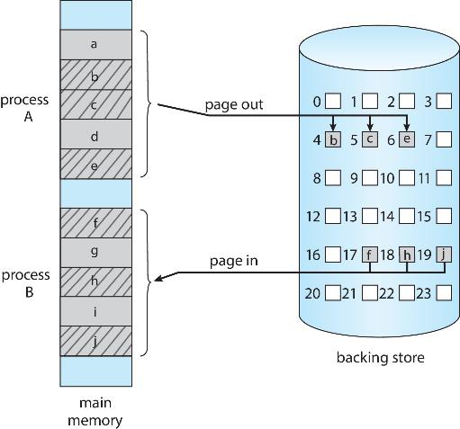
Swapping with Paging

Slide 16
Fragmentation
External Fragmentation – total memory space exists to satisfy a request, but it is not contiguous
Internal Fragmentation – allocated memory may be slightly larger than requested memory; this size difference is memory internal to a partition, but not being used
First fit analysis reveals that given N blocks allocated, 0.5 N blocks lost to fragmentation
1/3 may be unusable -> 50-percent rule

Slide 17
Fragmentation (Cont.)
Reduce external fragmentation by compaction
Shuffle memory contents to place all free memory together in one large block
Compaction is possible only if relocation is dynamic, and is done at execution time
I/O problem
Latch job in memory while it is involved in I/O
Do I/O only into OS buffers
Now consider that backing store has same fragmentation problems

Slide 18
Paging
Physical address space of a process can be noncontiguous; process is allocated physical memory whenever the latter is available
Avoids external fragmentation
Avoids problem of varying sized memory chunks
Divide physical memory into fixed-sized blocks called frames
Size is power of 2, between 512 bytes and 16 Mbytes
Divide logical memory into blocks of same size called pages
Keep track of all free frames
To run a program of size N pages, need to find N free frames and load program
Set up a page table to translate logical to physical addresses
Backing store likewise split into pages
Still have Internal fragmentation
Notes:
Paging is a memory management method that allows programs to use virtual memory addresses for efficient memory allocation. Whereas, fragmentation is an inefficient use of memory wherein the memory is divided into small chunks, which leads to the wastage of space.
When the blocks are allocated to a file in such a manner that every logical block of the file gets a contiguous physical block in the hard disk, then this allocation scheme would be known as a contiguous allocation.

Slide 19
Address Translation Scheme
Address generated by CPU is divided into:
Page number (p) – used as an index into a page table which contains base address of each page in physical memory
Page offset (d) – combined with base address to define the physical memory address that is sent to the memory unit
For given logical address space 2^{m} and page size 2^{n}

Slide 20
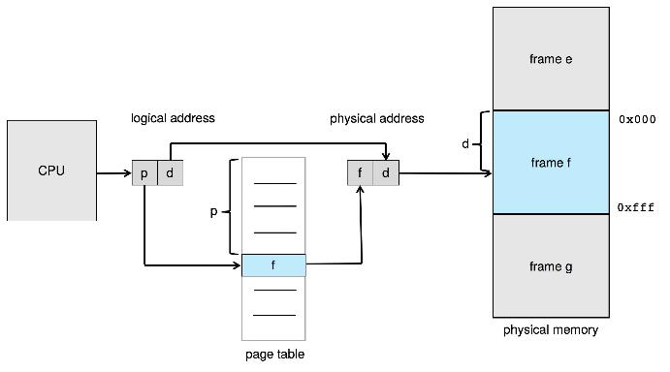
Paging Hardware

Slide 21
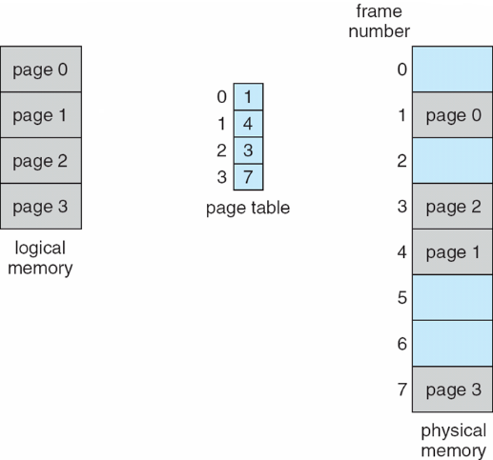
Paging Model of Logical and Physical Memory

Slide 22
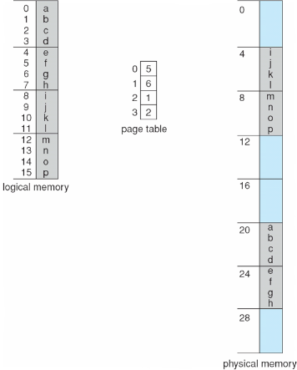
Paging Example
Logical address: n = 2 and m = 4. Using a page size of 4 bytes and a physical memory of 32 bytes (8 pages)

Slide 23
Virtual memory
Virtual memory – separation of user logical memory from physical memory
Only part of the program needs to be in memory for execution
Logical address space can therefore be much larger than physical address space
Allows address spaces to be shared by several processes
Allows for more efficient process creation
More programs running concurrently
Less I/O needed to load or swap processes

Slide 24
Virtual memory (Cont.)
Virtual address space – logical view of how process is stored in memory
Usually start at address 0, contiguous addresses until end of space
Meanwhile, physical memory organized in page frames
MMU must map logical to physical
Virtual memory can be implemented via:
Demand paging
Demand segmentation

Slide 25
Books
Operating Systems Concept
Written by Galvin and Silberschatz
Edition: 9th

Slide 26
References
Operating Systems Concept
Written by Galvin and Silberschatz
Edition: 9th

